Slide 1
Digital Portfolio
STUDENT NAME : NAVI.R
REGISTER NO AND NMID : 291D9ADFDD72EB78C4C42FC64F0C6367
DEPARTMENT : DEPARTMENT OF COMPUTER
APPLICATION
COLLEGE: AMBARI COLLEGE OF ARTS AND SCIENCE
FOR WOMEN
UNIVERSITY : THRIVALLUR UNIVERSITY

Slide 2
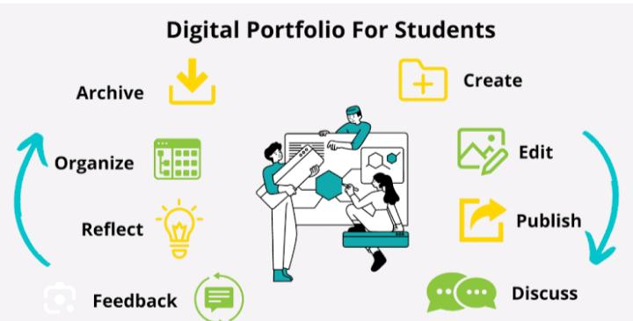
PROJECT TITLE
INTERACTING DIGITAL PORTFOLIO WITH FRONT END DEVELOPMENT

Slide 3


AGENDA
Problem Statement
Project Overview
End Users
Tools and Technologies
Portfolio design and Layout
Features and Functionality
Results and Screenshots
Conclusion
Github Link
3/21/2024 Annual Review

Slide 4

PROBLEM STATEMENT
An interacting digital portfolio with a modern web front-end uses technologies like HTML, CSS, and JavaScript to create a dynamic, engaging showcase of skills, projects, and achievements, making it easy for users or recruiters to explore information and connect with the author.
A concise problem statement for a digital portfolio front-end development project could be:" Design an interactive portfolio website with a responsive and intuitive front-end, enabling users to efficiently explore project details, personal achievements, and contact information, while ensuring excellent usability and visual appeal using web standards and best practices.
.

Slide 5
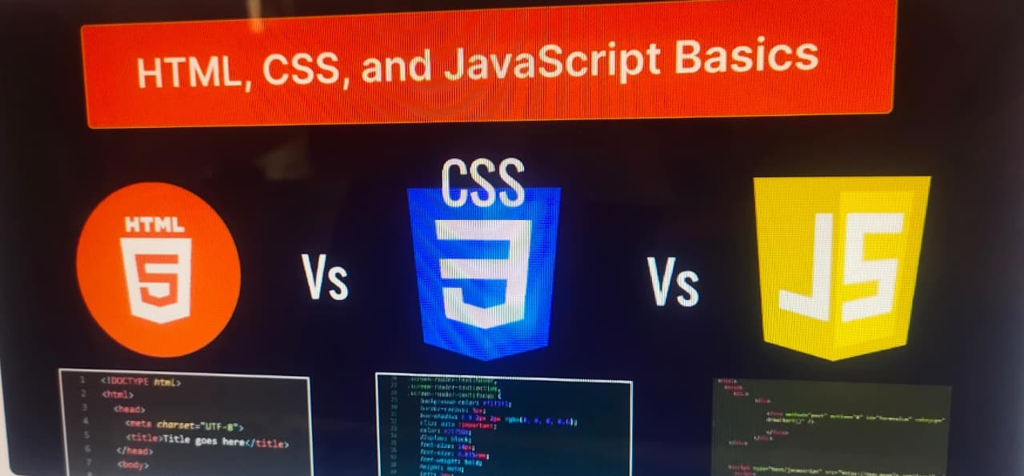
Key Features
Approaches Interactivity.
Responsive Design.
Project Overview
Contact Section.
Customization & Branding.
Code Repository Hosting.

Slide 6

PROJECT OVERVIEW
An interacting digital portfolio with a web front-end leverages dynamic and engaging features—like clickable project sections, interactive animations, and responsive designs—to demonstrate your technical and creative skills in an online format that users can actively explore.
A strong digital portfolio project overview should clearly communicate the
following components:
Goals & Audience: Define the portfolio's intended purpose (e.g., job search, freelance work) and the viewers you aim to impress (e.g., hiring managers, clients).
Interactive Navigation: Implement clickable elements that guide visitors through case studies, stages of development, and project achievements, such as interactive grids or animation-driven storytelling.

Slide 7
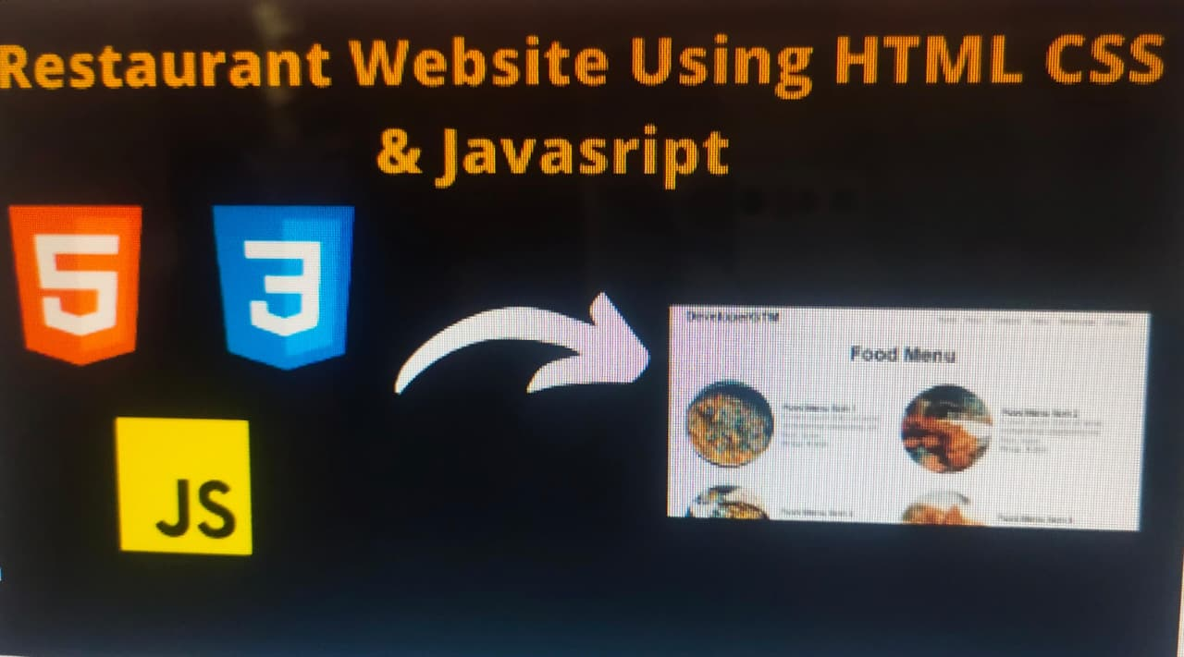
Live Demos & Code Samples: Include links to live versions of projects and code repositories to build credibility and show technical depth.
WWW Front-End Technologies To build an interactive digital portfolio.
front-end technologies include: HTML, CSS, and JavaScript: Core scripting for layout, styling, and interaction.

Slide 8

WHO ARE THE END USERS?
The end users of a digital portfolio: Hiring managers and recruiters, who review portfolios to evaluate skills, experience, and fit for job roles. Potential clients or customers, especially for freelancers and service providers, who want to see proof of capabilities and past work. Industry professionals and collaborators, who may assess expertise for partnerships or referrals. Educators and mentors, for students or professionals seeking feedback or academic evaluation. Self or personal branding audience, anyone interested in the individual’s professional identity and work history. These users typically look for clarity, relevance, evidence of skills, creativity, and impact demonstrated through the portfolio content. The target audience varies by profession (e.g., designers, writers, marketers) but usually involves people who make decisions about hiring, contracting, or networking based on the portfolio

Slide 9

TOOLS AND TECHNIQUES
HTML, CSS, and JavaScript are the foundational technologies of front-end web development, and a wide array of tools and technologies build upon them to enhance development efficiency and user experience.
Core Technologies:
HTML (Hypertext Markup Language):
Provides the structure and content of web pages using a system of tags.
CSS (Cascading Style Sheets):
Defines the visual presentation and styling of HTML elements, controlling aspects like layout, colors, fonts, and responsiveness.
JavaScript:
Adds interactivity and dynamic behavior to web pages, enabling features like animations, form validation, and real-time content updates.

Slide 10
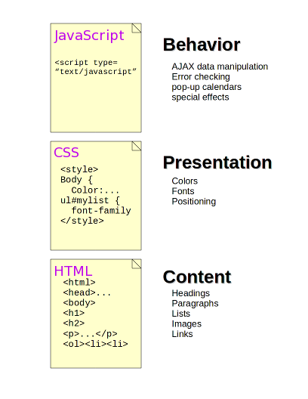
Development Tools:
Code Editors.
Browser Developer Tools.
.Version Control Systems.
Package Managers.
.Task Runners/Bundlers.
Frameworks and Libraries:
JavaScript Frameworks/Libraries.
jQuery:.
CSS Frameworks/Preprocessors.
Other Notable Technologies:
TypeScript.
Headless CMS.
Static Site Generators.
This Photo by Unknown Author is licensed under CC BY

Slide 11
POTFOLIO DESIGN AND LAYOUT
To build an interactive digital portfolio with a WWW front end, essential tools and technologies include a combination of markup, styling, interactivity, frameworks, and portfolio platforms designed for developers and creatives in 2025.Core Front-End Technologies HTML structures content on the web and forms the backbone of all portfolio websites.
CSS styles layouts and designs for an engaging user experience.
JavaScript adds interactivity, animation, and dynamic features to portfolios.
Popular Frameworks and LibrariesReact.js, Angular, Vue.js, and Svelte are leading frameworks for building responsive, interactive portfolios, offering reusable components and advanced UI logic. Bootstrap and SASS streamline styling, responsiveness, and rapid prototyping for visually appealing layouts.Next.js and Gatsby are optimal for building modern, fast-loading portfolio sites with React—often supporting server-side rendering and static site generation.
Essential Development Tools Code is a widely favoured code editor for front-end development, providing extensive plugin support for web technologies. Chrome DeVos's assists with inspecting, debugging, and refining front-end code to optimize portfolios.
Figma is popular for designing UI prototypes and exporting assets for front-end builds. Portfolio Creation PlatformsPortfoliobox, Wix, Squarespace, Layers, Be hance, WordPress offer drag-and-drop or template-based portfolio creation, integrated blogging, galleries, and interactive showcases
11

Slide 12

Layers integrates directly with GitHub for seamless project showcases
Figma portfolio templates allow creative, customizable design options for visual-centric portfolios before translating to web. Frontend Mentor and Rechallenges enable practice of real-world front-end skills, making them ideal for impressively interactive portfolio builds.
Key Features
an Interactive Portfolio Responsive design for mobile and desktop Interactive UI elements such as animations, transitions, and galleries Integration with coding platforms (GitHub, GitLab)SEO optimization and analytics for visitor tracking Multimedia content (images, videos, live demos)Contact forms and service showcase sections To summarize, combining foundational web technologies (HTML, CSS, JS), modern frameworks (React, Vue, Bootstrap), rich development environments, and robust portfolio platforms like Wix, Squarespace, Portfolio box, and Layers enables the creation of standout, interactive digital portfolios for web front-end developers in 2025

Slide 13
FEATURES AND FUNCTIONALITY
An interacting digital portfolio with a modern web front-end is a dynamic website designed to showcase work, skills, and achievements through interactive features and engaging functionality.
Core Features of Digital Portfolio Responsive design ensures seamless viewing on all devices, which is essential for professional and accessible presentation. Clear navigation allows users to intuitively explore sections like About, Projects, Skills, Experience, and Contact. Projects section with detailed case studies, images, live demos, and clickable components lets viewers engage with actual work
About me : skills section gives insight into expertise, technology stack, and personal background.
Contact forms : social media links facilitate professional communication directly from the site.
Interactive Functionality : Animations and transitions (e.g., hover effects, parallax scrolling, animated logos) enhance visual appeal and user engagement.
Theme: switchers allow users to toggle between light and dark modes for customized viewing.
Dynamic showcases: such as flipbooks, interactive timelines, modal galleries, or embedded videos bring achievements and projects to life.
Testimonials or client feedback: establish credibility and trust, important for freelancers and job seekers.Popular Tools and Technologies :HTML, CSS, JavaScript are standard for front-end structure, styling, and interactivity.

Slide 14
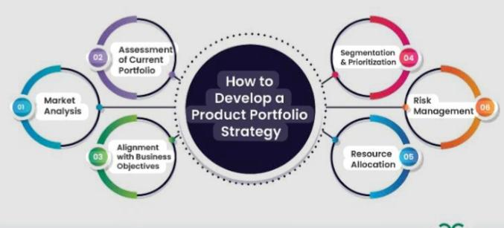
Frameworks and site builders such as React, Angular, Web flow, Wix, Squarespace, WordPress (with page builders like Element or or Divi) provide customizable experiences and modern design features. Creative platforms like Be hance, Dribble, and Art Station host interactive portfolios for networking and exposure.
Example
Portfolio Components Navigation bar for easy access to sections. Hero section with personal tagline and action buttons. Interactive galleries/slideshows to present visual work. Embedded multimedia (video, audio, animations).Project breakdowns and process walkthroughs. Best Practices Prioritize UX through simple structure and quick-loading pages. Integrate interactive components that highlight skills relevant to front-end web development. Use high-quality images and concise, impactful text to tell the professional story. A successful interacting digital portfolio combines these features and functionalities to demonstrate technical ability, creativity, and professionalism in web front-end development

Slide 15

RESULTS AND SCREENSHOTS
An interacting digital portfolio with a www front-end development focus is a web-based portfolio site that showcases a developer's skills, projects, and experience through an engaging and interactive user interface. Such a portfolio typically includes a clean, responsive design, detailed project case studies, animated or interactive elements, and smooth navigation, helping to attract potential employers or clients by demonstrating both technical proficiency and creativity.
Key Features
an Interacting Digital Portfolio (Front-End Focus)Interactive Elements: Animations, hover effects, interactive navigation, and gamified components (e.g., Robby Leonardi’s gamified resume experience)
.Project Showcases: Detailed project pages explaining objectives, tech stack, role, challenges, and links to live demos or repositories. Skills & Expertise .
Display: Clear listing of technical skills, often visually represented by icons or progress bars. Personal Branding: Use of consistent theme colors, typography, logos, and sometimes a personal photo or video intro.
3/21/2024 Annual Review
15

Slide 16
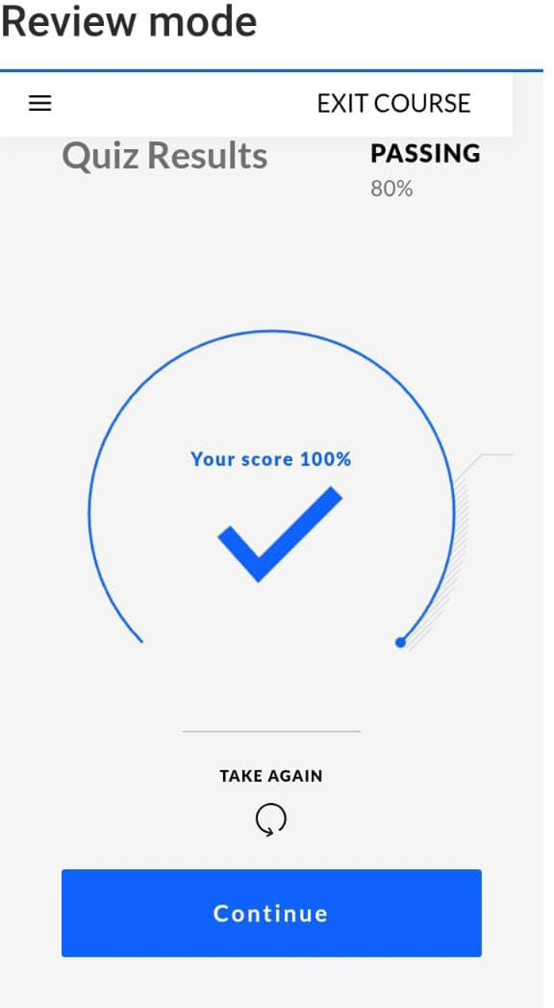
Social Proof: Testimonials, client feedback, and links to professional networks. User Experience: Responsive design for mobile and desktop, easy navigation, and fast loading times
Examples
Inspiration Pascal van Gemert's portfolio uses a terminal-inspired creative design with interactive content and career roadmap visualization. Brittany Chiang’s portfolio features sleek modern design, smooth scrolling, and detailed project case studies. Robby Leonardi’s portfolio offers a unique gamified interactive resume interface showcasing creativity and front-end skills memorably
Use engaging, intuitive UI elements such as hover effects and animations to draw attention. Provide context and details for each project to give insight into your development process. Include a contact form or call to action to invite inquiries. Keep a clean, consistent design that's mobile-friendly and optimized for performance. Incorporate testimonials or endorsements to boost credibility. Screenshot

Slide 17
CONCLUSION
An interacting digital portfolio with a front-end development focus offers key benefits including showcasing skills, highlighting projects with interactive elements, demonstrating creativity, and establishing a personal brand. The front-end development aspect emphasizes building visually appealing, responsive, and user-friendly interfaces using modern frameworks and technologies.
This combination makes the portfolio not only a display of technical expertise but also an engaging and memorable experience for potential employers or clients.
Benefits of an Interacting
Digital Portfolio Showcases skills effectively: Displays programming languages, tools, certificates, and professional experience.
Highlights projects interactively: Uses animations, transitions, and dynamic elements to demonstrate real-world applications.
Demonstrates creativity and versatility: Allows adding visual design and interactive features to stand out.
Builds personal brand: A professional portfolio establishes identity and credibility in the field
.Attracts potential clients and employers: Makes a strong impression and eases evaluation of skills.
17

Slide 18
Highlights of Front-End Development
The Portfolio Employs modern frameworks and libraries that enable rapid development and real-time programming.
Focuses on responsive design ensuring accessibility across devices. Enhances user engagement through dynamic UI components and smooth interactions.
SEO optimization to improve the portfolio's visibility online. Continuous updates and performance optimization are essential.
Summary
Creating an interactive digital portfolio centred on front-end development uniquely combines technical proficiency with creative expression.
It serves as a powerful marketing tool to showcase comprehensive skills and projects, gives you a platform to creatively present your work, and improves career opportunities by attracting employers and clients with its polished, professional appearance and functionality.
This approach benefits developers by enhancing their brand, demonstrating their capabilities, and opening doors in the competitive tech market.

Slide 19
THANK YOU!!!!!…

